Slide 1

Checkers
Course Project for CSCI 352
Connor Walsh, Daniel Cunningham

Slide 2
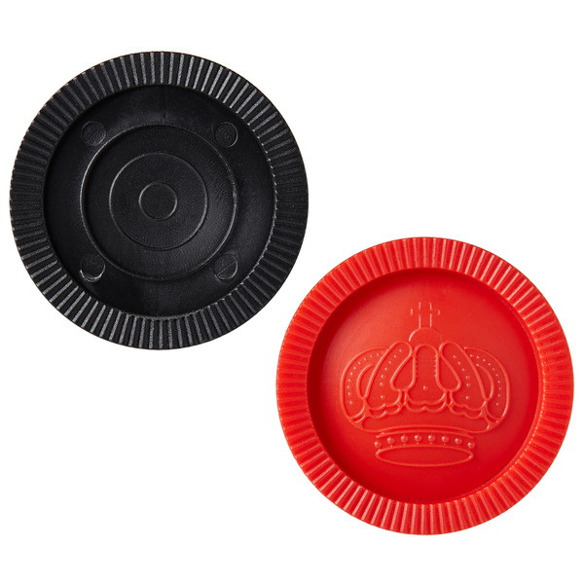
Background
This project is a two-player checkers game that can be played offline
Enforces the rules of an actual game of checkers
Customization
We chose to create a checkers program because we wanted to adapt a board game.
We originally wanted to adapt chess.
This project is mainly for people who are already familiar with checkers.

Slide 3
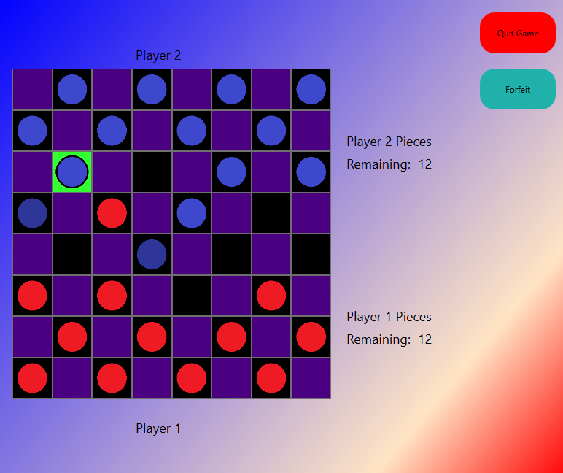
Approach
We made the checkerboard out of a grid and buttons.
The checker pieces are png image files with transparent backgrounds.
Windows in our program use the LinearGradientBrush class.
We did not use any special libraries or drivers.
We used the factory design pattern.
We used the decorator pattern.

Slide 4
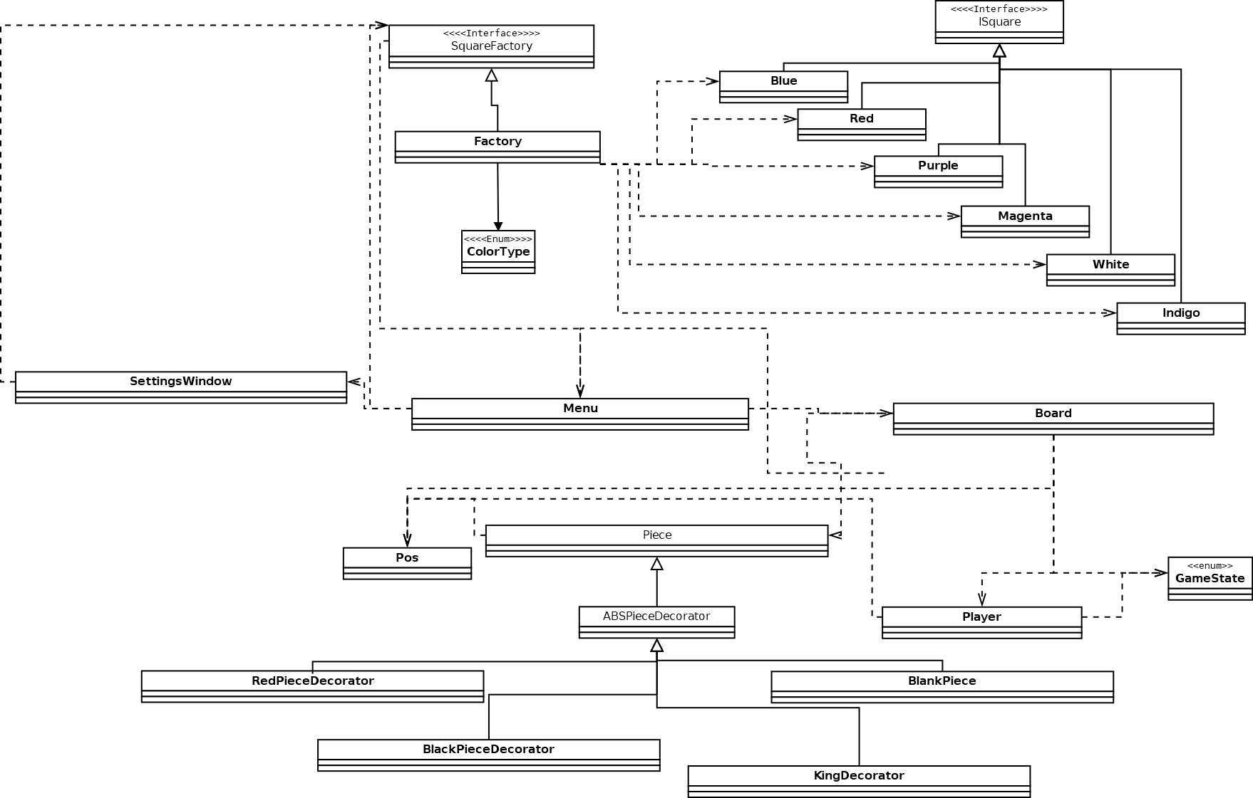
Class Diagram UML
The Factory method can be seen at the top.
The decorator is at the bottom.
The middle shows the different windows in the program.

Slide 5
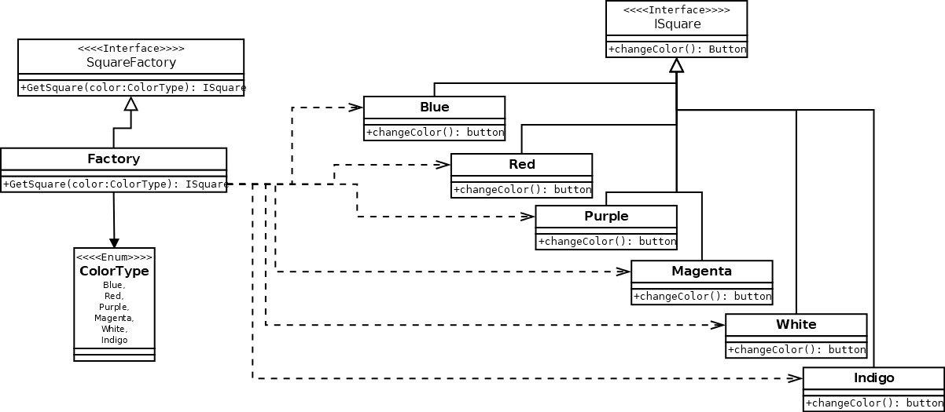
Class Diagrams: Factory Pattern UML
SquareFactory interface is inherited by the Factory class.
The GetSquare method uses enumeration.
Square classes inherit from the ISquare Interface.

Slide 6
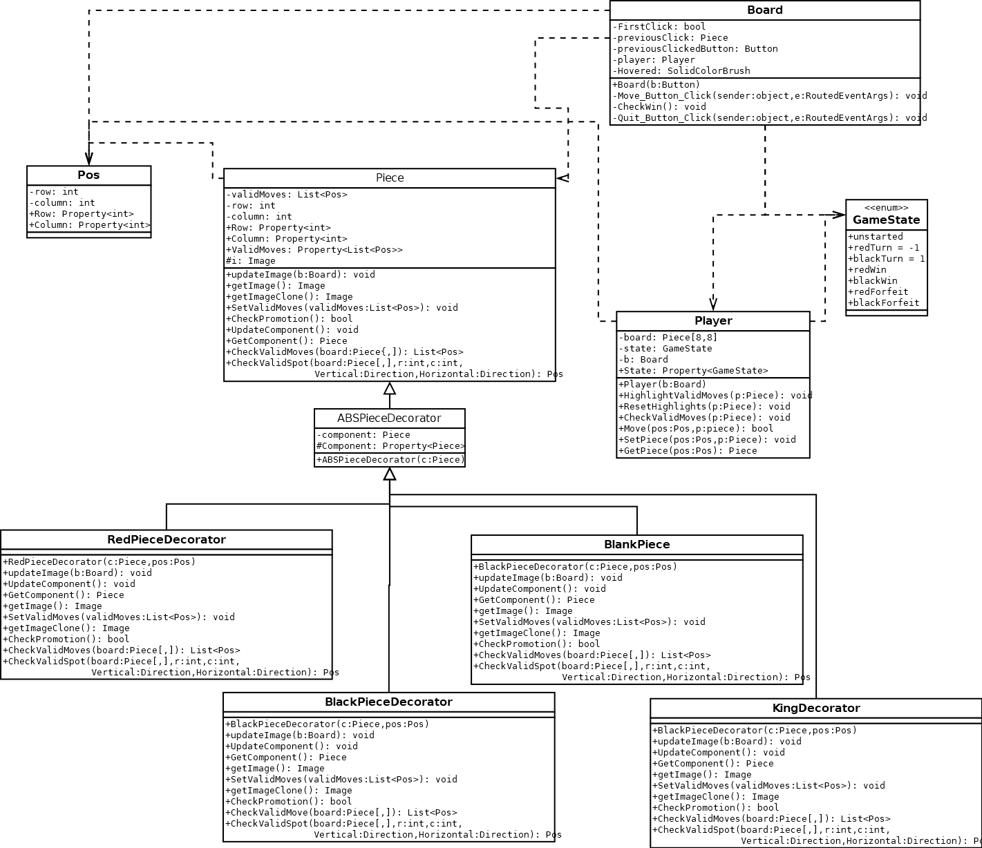
Class Diagrams: Decorator UML
Four different decorators
The program checks the valid moves of the pieces using the decorator methods.
CheckValidMoves method checks the component and uses its methods if it is not null.
Valid moves are displayed to the player through move highlighting.
The player object either takes the pieces or swaps the blank space with the correct decorator in order to move.

Slide 7
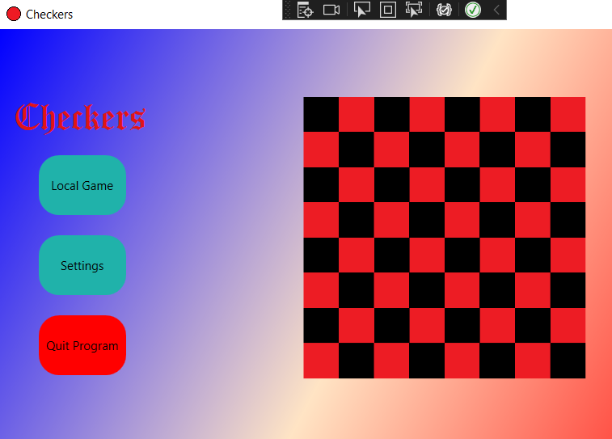
Checkers Game Demo
In order to begin the checkers game, click “Local Game” at the main menu of the program.
The red pieces move first.
Board color can be chosen from the menu.

Slide 8
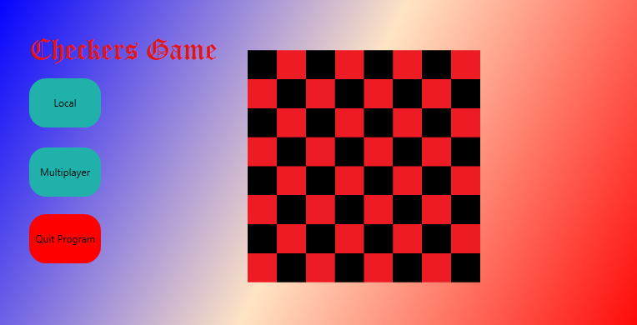
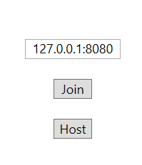
Future Work
Multiplayer
Save and load game feature

Slide 9
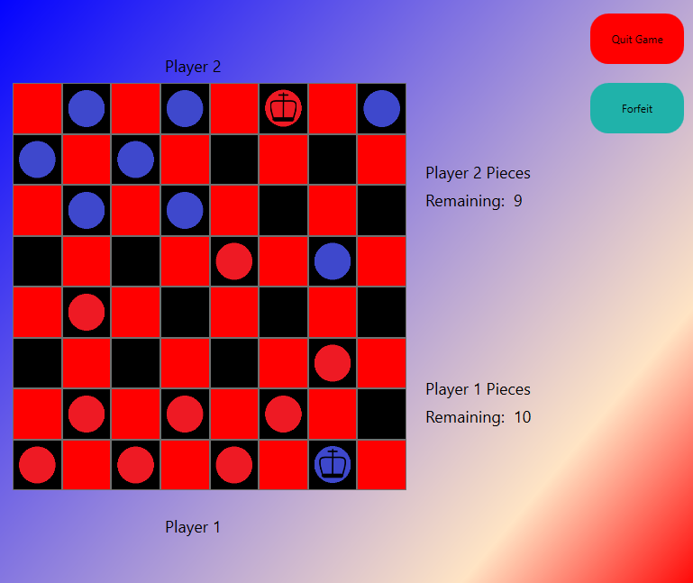
Questions?
cwalsh24@ut.utm.edu
danrcunn@ut.utm.edu
Connor’s Repo:
https://github.com/cwalsh24
Daniel’s Repo:
https://github.com/Daniel-Cunningham02
Project Repo:
https://github.com/Daniel-Cunningham02/CSCI-352-Checkers-Project

